Slide 1
COVID-19 Webinar
June 4, 2020
By Celly Services, Inc.

Slide 2
Agenda
COVID-19 Plan Implementation
OSHA Regulations + Enforcement
Worker’s Compensation, California Updates

Slide 3
CSI COVID-19 Materials
Plan
Checklist

Slide 4
CSI COVID-19 Plan
Executive Team Action Items
COVID-19 Overview + Workplace Assessment
Training Summary
Cleaning Protocols + Automobile Sanitizing
Physical Distancing + Travel Restrictions
Appendices
Note: Local Health Order + LA County Checklist merged into our checklist

Slide 5
Management Action Items
Identify Executive team + Post Contact Information (Pages 1&30) on Notice Boards (Pages 1&30)
Request completion of ‘Employee Acknowledgement Form’ (Page 31)in a timely manner
Post Completed Checklist (Pages 20-22) on Employee Notice Board

Slide 6
Hierarchy of Controls
Hazard Elimination
Digitize Communication
Engineering Controls
Administrative Controls
PPE

Slide 7
COVID-19 Occupational Risk Pyramid
Very High
High
Medium
Lower Risk
Workers with minimal occupational contact with public and coworkers
Those who have contact with general public (schools, high volume retail settings)
Health care delivery/support, medical transport
Healthcare and morgue workers collecting/handling specimens from potentially infectious or infected patients

Slide 8
Local Jurisdictions
Control site of car sale location
Allow mandatory employee temperature checks (San Diego)
Require face masks at essential businesses (LA County, Santa Barbara County)
CDC recommends cloth face coverings should not be placed on children younger than 2 years old or those unable to remove the mask without assistance.

Slide 9
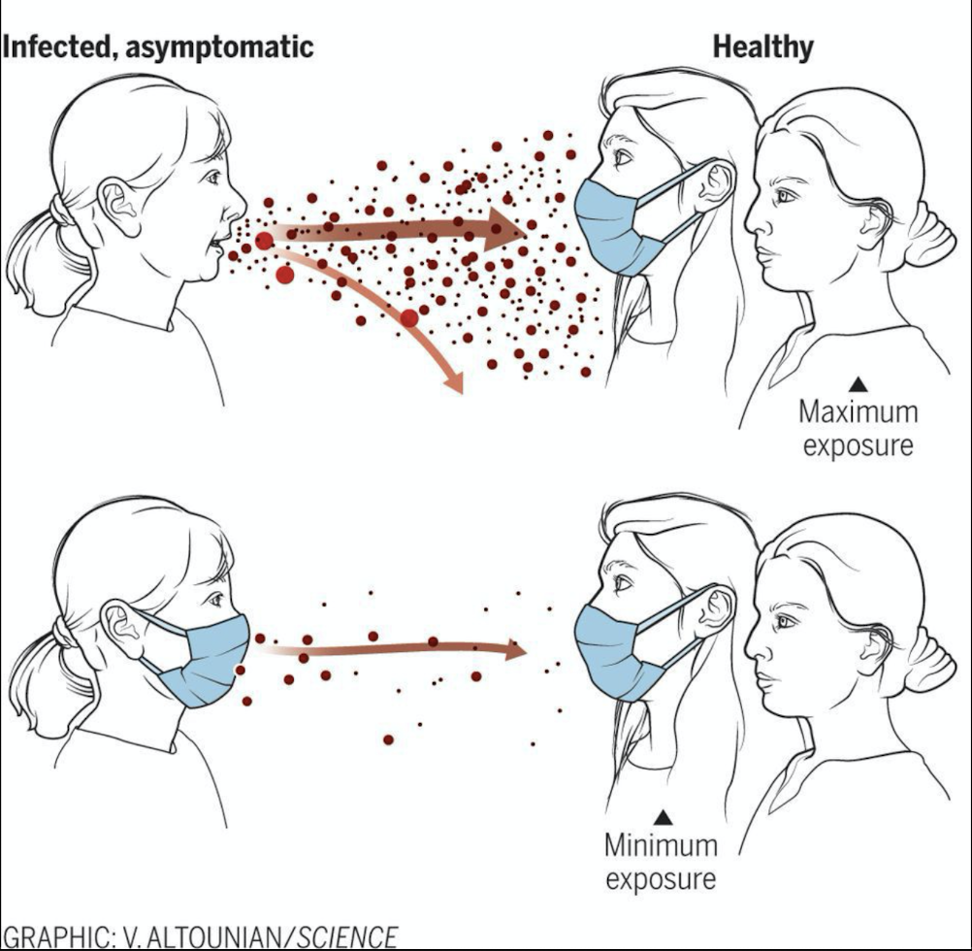
COVID-19 Overview
Transmission occurs via coughs or sneezes from an infected that can reach others within 6 feet
A single sneeze can release up to 300,000 droplets that travel at 200 miles per hour

Slide 10
Self Monitoring
CDC Phone Application
CDC recognized symptoms

Slide 11
COVID-19 Symptoms
Fever or chills
Mild or moderate difficulty breathing
Sustained loss of smell, taste, or appetite
Sore throat
Vomiting or diarrhea
Body aches

Slide 12
Call 911 If Experiencing
Severe, constant chest pain or pressure
Extreme difficulty breathing
Severe, constant lightheadedness
Serious disorientation or unresponsiveness

Slide 13
Vulnerable Populations
65+
Moderate to severe asthma
Kidney failure
Extreme obesity
Pregnant
Diabetes with complications
Immunosuppressed

Slide 14
Workplace Guidelines
Distribute employee specific training
Provide PPE
Distancing
(Visible 6ft markings, Plexiglass)
Employee to employee
Employee to customer
Customer to customer

Slide 15
Ventilation Get fresh air to the workers/workplace and properly utilize ventilation system.
Maintain relative humidity at 40-60%.
02
Ensure restroom is under negative pressure.
03
Maximize fresh air through your ventilation system.
01

Slide 16
Restroom Guidelines
Doors to multi-stall restrooms should be able to be opened and closed without touching handles if possible.
For single restrooms, provide signage and materials (paper towels and trash cans) for individuals to use without touching the handles.
Place signs indicating that toilet lids (if present) should be closed before flushing.
Place signs asking employees to wash hands before and after using the restroom.

Slide 17
Restroom Guidelines cont.
Provide paper towels in restrooms and disconnect or tape-off hand air dryers.
Double efforts to keep bathrooms clean and properly disinfected.
Provide for additional hand washing stations with soap and water in common areas and throughout the site. – Also provide hand sanitizer

Slide 18
Manager Training
Train
& Communicate with employees regarding developing circumstances
Evaluate
The workplace for compliance; document + correct deficiencies
Identify
Close contacts to an infected employee or visitor
Follow
Guidelines provided to prevent spread of coronavirus and isolate employees

Slide 19
Employee Trainings include
COVID-19 prevention, symptoms, and vulnerable populations
Conducting self screening prior to entering facility
Importance of not coming to work if experiencing any COVID-19 symptoms or have been in contact with someone diagnosed with COVID-19

Slide 20
Employee Tests Positive for COVID-19
Isolate employee to area they are currently in
Any individuals working with employee shall also be isolated + follow social distancing rules
General manager shall be notified
Remove employee who tested positive for 14 days minimum
Follow primary care physician instructions
Follow CDC and health care guidance
Follow CDC return-to-work protocol + HR return-to-work process, if applicable

Slide 21
Employees with non-COVID-19 illness
Send employees displaying similar symptoms should be sent home for 72 hours minimum
May return to work after 72 hours if symptom free without aid of medication. Seek MD advice.
Trace 48 hours prior to onset of symptoms for personnel that had contact with affected employee

Slide 22
Employee Health Reminders
Asymptomatic people can carry the active virus without developing symptoms
Pre-symptomatic people have been infected and are incubating the virus but do not display symptoms yet
Employees who have tested positive must stay in isolation for at least 10 days after the first sign of symptoms and have been symptom for at least 3 days without medication

Slide 23
Symptom Review and Temperature Checks
Lawyers have advised that employee temperature checks + symptom checks be considered mandatory.
OSHA: General Duty Clause requires a safe workplace.

Slide 24
Cleaning + Disinfectant Protocols
Use
Identify
Ensure
Request
EPA-approved supplies and follow directions
High-traffic areas and clean them more frequently
Proper PPE usage (glasses, gloves, etc.) as described in the SDS
Employees and customers provide Janitorial Staff access to areas as needed

Slide 25
Automobile Sanitizing
Sanitize all touchpoints
Wear fresh gloves for each vehicle
Lower windows and keep fan off
Use covers for steering wheels and seats and floormats
Read SDS for COVID-19 listed disinfectants and use PPE as described

Slide 26
Appendices
A – D) Employee Specific Training Guides
E) Prevention Checklist + Posters
F) Sample Incident Reporting + Response Form
G) Cleaning + Sanitizing Guidelines
H) Symptom Review + Temperature Scan Log
I) Contact Form
J) Employee Acknowledgement Log

Slide 27
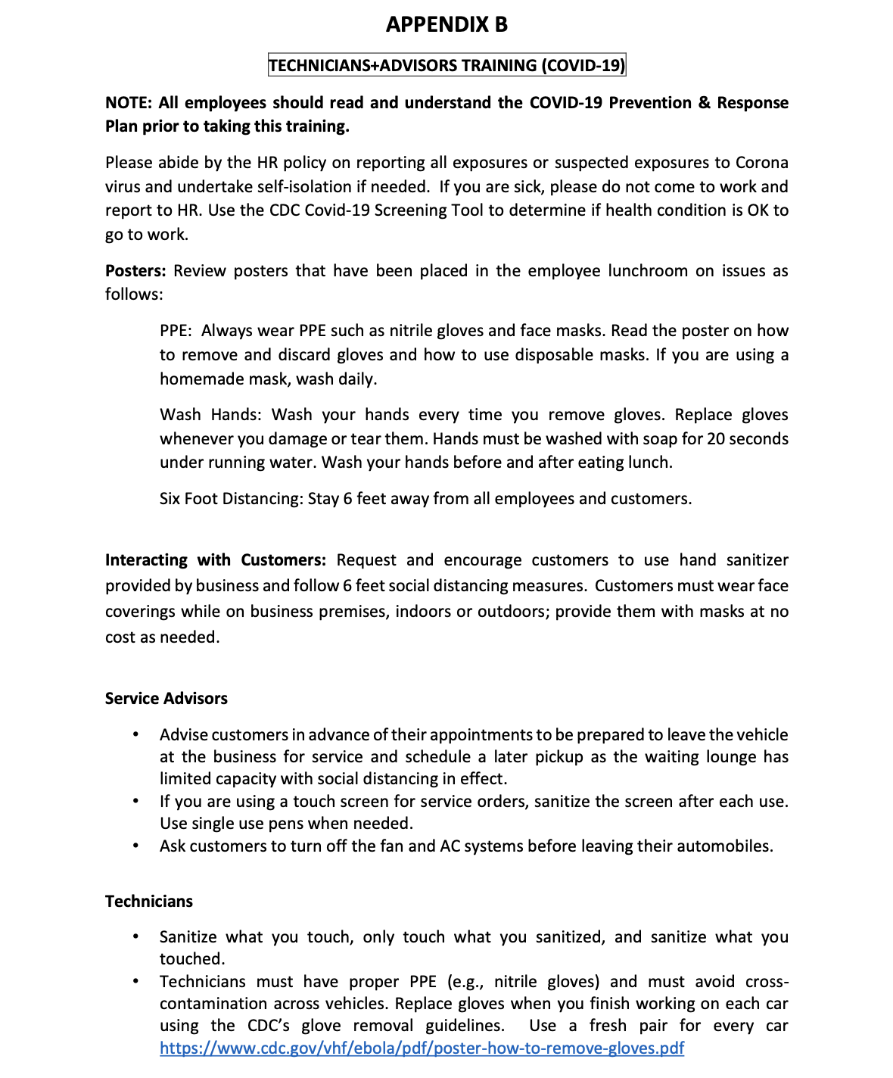
Appendix B

Slide 28
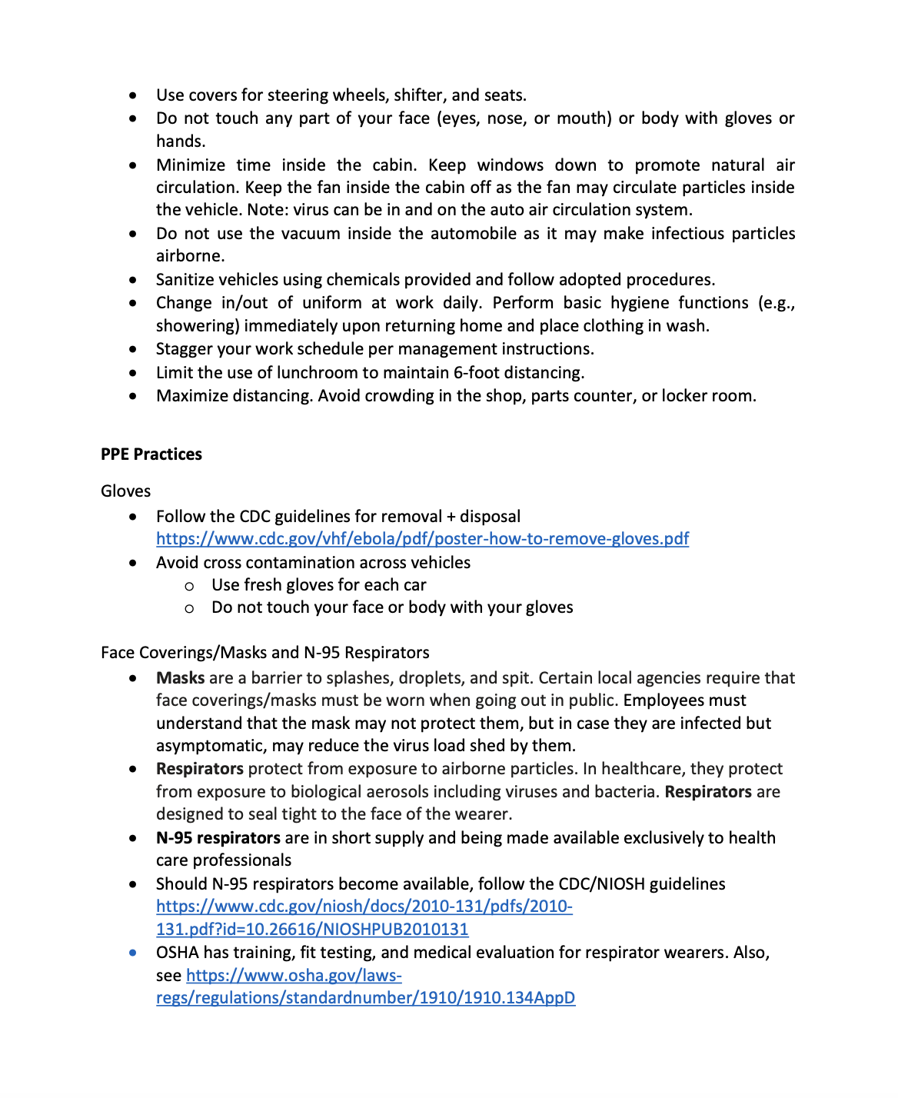
Appendix B (cont.)

Slide 29
Appendix E - Checklist
☐ Business must implement all applicable measures listed below and be prepared to explain why any measure that is not implemented is inapplicable to the business.
☐ Review CDC Website daily for general information and updates: www.cdc.gov
☐ Supply List: Infra-red thermometers (FDA approved), Gloves, Masks, Hand Sanitizer, Soap, Paper towels, Auto Disinfectant, Disposable Pens, Sanitizing Wipes and Disinfectant solution.
Signage
☐ Signage at each public entrance of the facility to inform all employees and customers that they should: avoid entering the facility if they have COVID-19 symptoms; maintain a minimum six-foot distance from one another; sneeze and cough into a cloth or tissue or, if not available, into one’s elbow; wear face coverings, as appropriate; and not shake hands or engage in any unnecessary physical contact.
☐ Place tape or other markings at least six feet apart in customer line areas inside the store and on the sidewalks at public entrances to direct customers to maintain distance.

Slide 30
Appendix E - Checklist
Measures to Protect Employee Health (check all that apply to the facility)
☐ Implement a clear and simple HR policy prepared by legal counsel ☐ In case of a COVID-19 incident, contact your public health department and perform sanitizing operations.
☐ Everyone who can carry out their work duties from home has been directed to do so. ☐ All employees have been told not to come to work if sick. ☐ Symptom checks are being conducted before employees may enter the workplace. Include:
☐ Use “CDC COVID-19 Screening Tool” available for smart phone or other methods.
☐ Use Infra-red thermometers for employee temperature scans.
☐ Employees are required to wear face coverings.
☐ Require and enforce customers to maintain 6 feet social distancing and wear face coverings for their noses and mouths. Provide masks at no cost at building entrances.
☐ All desks or individual workstations are separated by at least six feet. ☐ Plexiglass (Sneeze guards) and other separators are installed where six feet distance cannot be met.
☐ No test drives are being conducted with potential buyers (use Borrower Car Agreement) ☐ Customers are being instructed to turn off AC prior to dropping off car. ☐ Sanitize vehicles before and after working on them. ☐ Maximize facility HVAC, ensure it is working properly and maintained. Use best filters (e.g., MERV-16).
☐ Maximize shop ventilation systems for exhaust removal and have airflow verified per local regulations. ☐ Shut down internal vacuuming of car.

Slide 31
Appendix E - Checklist
Measures to Protect Employee Health (check all that apply to the facility) cont.
☐ Wear PPE (e.g. gloves, face masks, etc.). ☐ Change in and out of uniform at work.
☐ Limit access to employee lounge and other common areas (meet specified physical distancing norms). ☐ Disinfect break rooms, bathrooms, and other common areas frequently, on the following schedule: ☐ Break rooms every ___________ ☐ Bathrooms every ___________☐ Other _________, every ___________ ☐ Disinfectant and related supplies are available to all employees at the following location(s): ______________________________________ ______________________________________ ☐ Hand sanitizer effective against COVID-19 is available to all employees at the following location(s): ______________________________________ ______________________________________ ☐ This plan has been distributed to all employees. ☐ Optional—Describe other measures: ____________________________________

Slide 32
Appendix E - Checklist
Measures to Prevent Crowds from Gathering (check all that apply to the facility)
☐ Stagger service appointments and car pick-ups to limit the number of customers in the store at one time.
☐ Implement a no-contact, early bird drop off for the service drive. ☐ Place signs requesting customers wait in their cars while the advisor comes to the car for the write up. ☐ Shut down dealer operated shared transport.
☐ Post a notice mandating single party use of elevators. ☐ Manager will walk each common area periodically (at least hourly) to ensure that the 6 feet distance is not
being violated. Manager will ensure that facility occupancy is limited to be compliant with social distancing. Manager Name ___________________________________ Location(s) Walked ___________________________________

Slide 33
Appendix E - Checklist
Measures to Keep People At Least Six Feet Apart (check all that apply to the facility)
☐ Placing signs outside the store reminding people to be at least six feet apart, including when in line. ☐ Placing tape or other markings at least six feet apart in customer line areas inside the store and on sidewalks at public entrances with signs directing customers to use the markings to maintain distance. ☐ All employees have been instructed to maintain at least six feet distance from customers and from each other, except employees may momentarily come closer when necessary to accept payment, deliver goods or services, or as otherwise necessary. ☐ Optional—Describe other measures: ____________________________________
Measures to Prevent Unnecessary Contact (check all that apply to the facility)
☐ Preventing people from self-serving any items that are food related. ☐ Bulk-item food bins are not available for customer self-service use. ☐ Request customers to use their own pens or provide single use pens for customer use. ☐ Providing for contactless payment systems or, if not feasible, sanitizing payment systems regularly.
☐ Provide paper floor mats, seat covers, and steering wheel covers for all vehicles.

Slide 34
Appendix E - Checklist
Measures to Increase Sanitization (check all that apply to the facility)
☐ Disinfecting wipes and/or Sanitizers Available at Customer Access Areas (Lounges/Cashers Window) ☐ Hand sanitizer, soap and water, or effective disinfectant is available to the public at or near the entrance of the facility, at checkout counters, and anywhere else where people have direct interactions. ☐ Disinfecting all payment portals, pens, and styluses after each use. ☐ Disinfecting all high contact surfaces per dealership plan. ☐ Add line to RO for customer approval of vehicle sanitization. ☐ Sanitize vehicles before and after servicing and test drives. ☐ Optional—Describe other measures: ___________________________________ * Any additional measures should be listed on separate pages and attached to this document. You may contact the following person with any questions or comments about this protocol: Name ___________________________________ Phone number ___________________________________

Slide 35
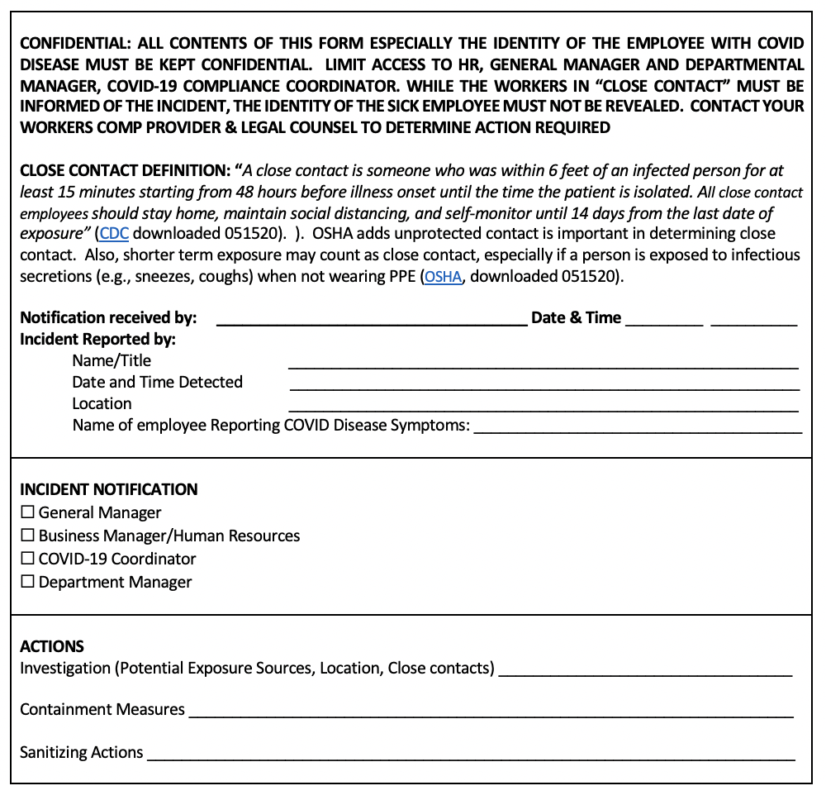
Appendix F
Incident Reporting + Response Form

Slide 36
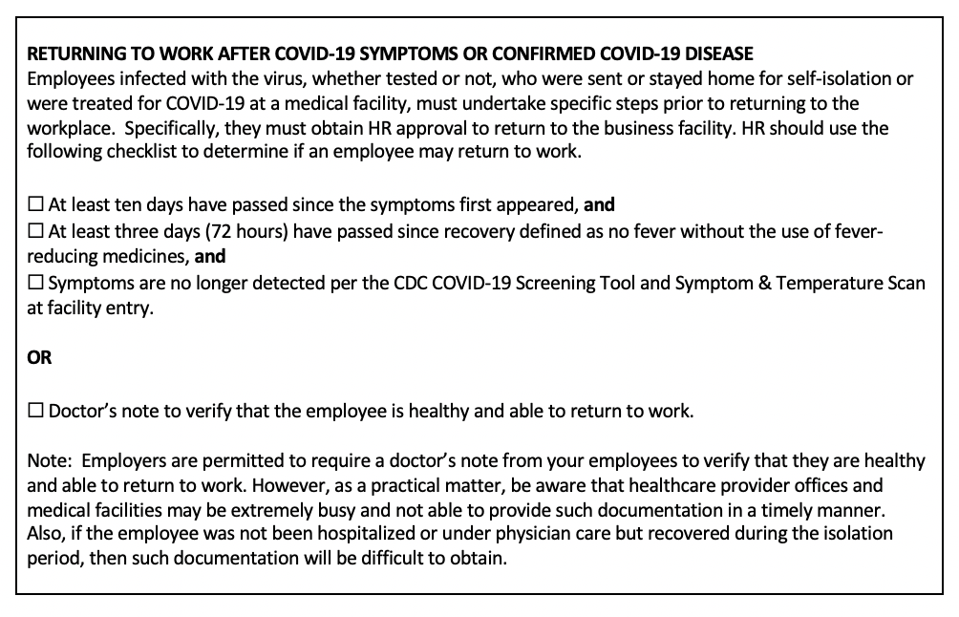
Appendix F
Incident Reporting + Response Form

Slide 37
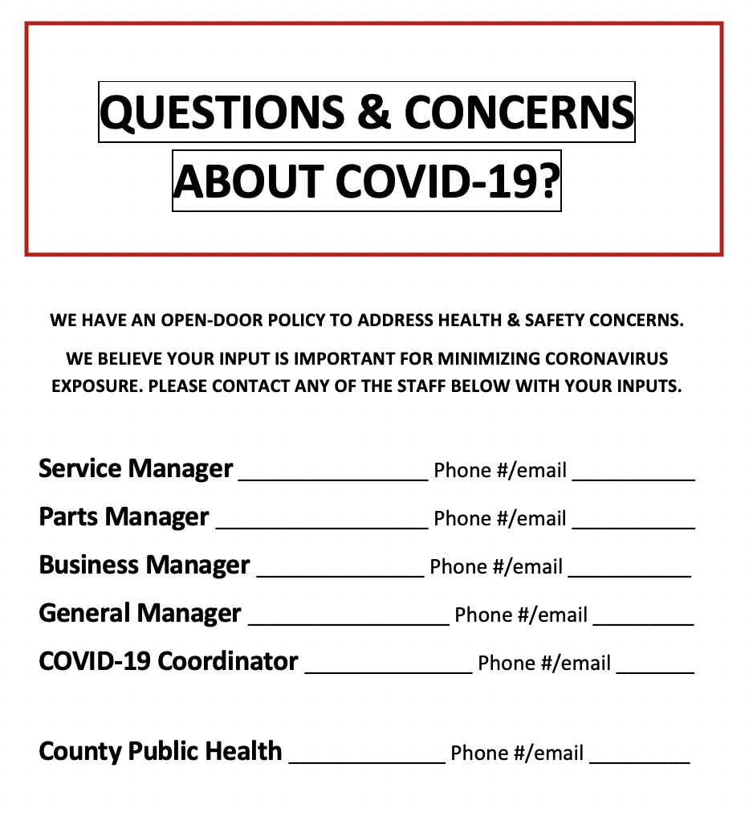
Appendix I Questions/ Concerns Form

Slide 38
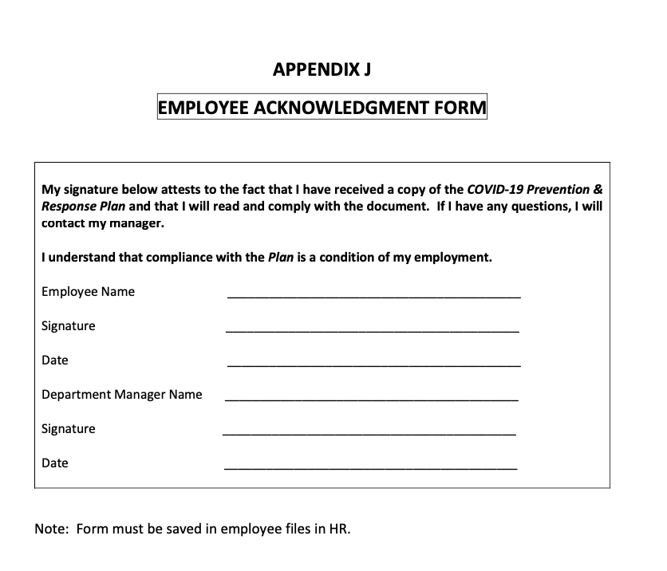
Appendix I Employee Form

Slide 39
CAL/OSHA April 17, 2020
Received 1,500 complaints against employers alleging failure to provide protection during the COVID-19 crisis

Slide 40
CAL/OSHA Reporting Guidelines Report within 8 Hours
Any inpatient hospitalization for work related injury or illness, for anything other than medical observation or diagnostic testing must be reported.
An amputation, the loss of an eye, or any serious degree of permanent disfigurement, but does not include any injury or illness or death caused by an accident on a public street or highway, unless the accident occurred in a construction zone.
Any fatality.

Slide 41
FED/OSHA Reporting Guidelines
Only fatalities occurring within 30 days of the work-related incident must be reported to OSHA.
Further, for an inpatient hospitalization, amputation or loss of an eye, then incidents must be reported to OSHA only if they occur within 24 hours of the work-related incident.
Fatalities
– within 8 hours of finding out about it
In-patient hospitalizations of one or more employees, amputations, losses of an eye
– within 24 hours of learning about it

Slide 42
OSHA Regulations
Personal Protective Equipment: Requires using gloves, eye and face protection, and respiratory protection when job hazards warrant it.
When respirators are necessary to protect workers, employers must implement a comprehensive respiratory protection program in accordance with the Respiratory Protection standard. Compliance requires an assessment of hazards and then proving proper PPE that addresses those hazards. PPE must be provided at no cost and employees provided with training in proper usage.
Hazard Communication Program: Protect their workers from exposure to hazardous chemicals used for cleaning and disinfection. Employers should be aware that common sanitizers and sterilizers could contain hazardous chemicals.
Where workers are exposed to hazardous chemicals, employers, must comply with this standard. Requirements include a written program, providing SDS, proper labels on containers and training on understanding the hazards related to chemicals in use.
General Duty Clause: Requires employers to furnish to each worker "employment and a place of employment, which are free from recognized hazards that are causing or are likely to cause death or serious physical harm."
This is literally the catch-all provision that OSHA inspectors can use when no standard seems to be violated.

Slide 43
Worker’s Compensation, Prior to May 6
AOE and COE required
Employee proves injury
Coronavirus exposure experience on the job results in COVID-19

Slide 44
Executive Order N-62-2 Effective May 6
Burden shifted to employer to prove exposure was not work related
Effective for work performed March 19 to July 5, 2020

Slide 45
Temporary Rebuttal Presumption of injury for an employee’s COVID-19 related illness
Work was performed on or after March 19, 2020
Employee was directed to perform work at a location other than employee’s home
Employee tested positive or was diagnosed with COVID-19 within 14 days after employee worked at employer’s direction
California-licensed physician made initial diagnosis, and that diagnosis is confirmed by further testing within 30 days of initial testing date

Slide 46
Period of Rejection
Shortened to 30 days from date of claim form filing
If not rejected within 30 days, the claim is presumed compensable, unless rebutted by evidence only discovered after 30-day period

Slide 47
Disclaimer
DISCLAIMER: Information regarding COVID-19 is dynamic and constantly evolving. Check reliable sources, such as www.cdc.gov, regularly to keep yourself updated, research other areas, and adopt procedures as they deem fit. Though we have used government sources to prepare this memo, we do not endorse or recommend any for a particular purpose. The information provided here is brief guidance for employers and employees to use to protect themselves in the workplace. There is no warranty implied or expressed regarding the completeness or accuracy of information presented here. The information provided here is not complete and/or exhaustive. Protections such as full body sealed suits and N95 respirators may further help reduce risks in the workplace and should be evaluated for use. This COVID-19 Prevention and Response Plan supersedes all information disseminated earlier. This document is prepared from the CDC, CDPH + Cal/OSHA, NIOSH, OSHA & EPA guidelines.
Employers and employees should understand that the SARS-CoV-2 virus and COVID-19 pandemic present serious and life-threatening health risks, and this is guidance suggests practical ways to reduce those risks, not eliminate them. This memo is not intended to constitute medical or safety advice or be a substitute for the same. Contact safety consultants, lawyers, and medical professionals to take appropriate course of action.
Sanjay Sam Celly, President of Celly Services, Inc., has been serving businesses’ workplace environmental, health, & safety needs, and assisting them in complying with EPA & OSHA regulations for the past 34 years. He received his BE (1984) & MS (1986) in Chemical Engineering, followed by a JD in 1997.

Slide 48
Acknowledgements
The contents of the CSI COVID-19 Plan + Checklist include information sourced from documents including
OSHA: COVID-19 Industry Guidelines for Auto Dealership + Rentals

