Slide 1
California & COVID-19 - The Latest Challenges, Gotchas & How to Protect Your Dealership
Dealership Best Practices for COVID-19 Safety & Compliance

Slide 2
About KPA
KPA’s mission is to help organizations maintain a safe and healthy workplace. We specialize in creating safer work environments for employees and the communities in which they work and live.
As the COVID-19 pandemic evolves, we’re committed to helping you keep your workforce healthy by providing free EHS and HR expertise and resources.
AUDIT/LOSS CONTROL
SERVICES
COMPLIANCE
SOFTWARE
WORKFORCE
MANAGEMENT
KPA’s COVID-19 Resource Center:
www.kpa.io/covid-19
Notes:
Before we jump into today’s presentation, I’d like to provide a quick introduction of KPA.
KPA provides Environment, Health & Safety (EHS), HR Management, and Finance & Insurance compliance software and services. These solutions help organizations maintain a culture of safety, lower risk for your employees and your business, and reduce costs.
KPA has over 30+ years of EHS and compliance experience. And as the COVID-19 crisis evolves, we believe in sharing our expertise to anyone who might benefit from it during this pandemic. KPA will continue to share our EHS and HR expertise and best practices with you by publishing free materials on our website and on our social media channels. Continue to check the URL listed here – kpa.io/covid-19 for up-to-date coronavirus resources including webinars, free safety trainings, and best practice guidelines.

Slide 3

Meet Your Speaker
Regina Metzker
West Team Supervisor
Sacramento, CA

Slide 4
What You’ll Learn Today
COVID-19 Risks Areas
COVID-19 Risk Mitigation Strategies
How dealerships can manage COVID-19 Response

Slide 5
Disclaimer
The information in this presentation is provided for general informational purposes only and may not reflect the current law in your jurisdiction.
Nothing in this presentation should be construed as legal advice from KPA or the individual presenters, nor is it intended to be a substitute for legal counsel on any subject matter. The views and opinions in this presentation are those of the presenter and do not necessarily represent official policy or position of KPA, or of its clients.
No attendee of this presentation should act or refrain from acting on the basis of any information included in this presentation without seeking the appropriate legal or other professional advice on the particular facts and circumstances at issue from a lawyer licensed in the attendee’s state, country or other appropriate licensing jurisdiction.

Slide 6
COVID-19 Risks Areas

Slide 7
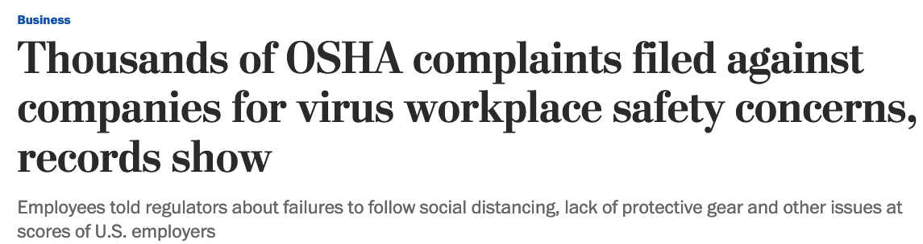
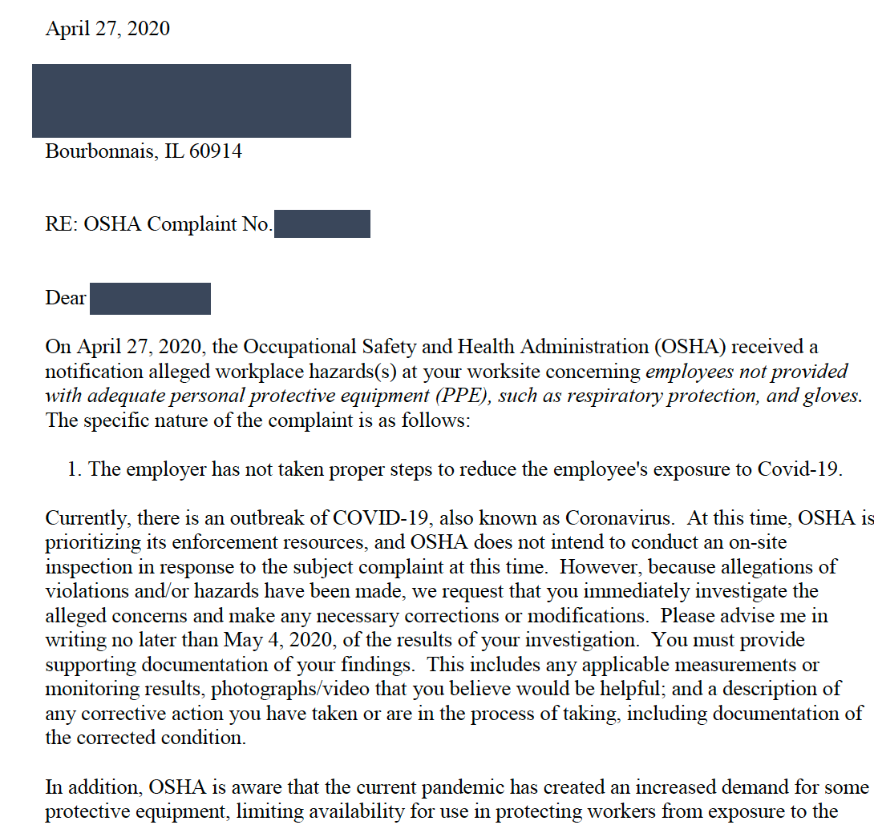
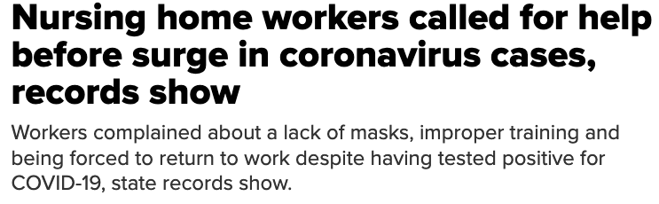
OSHA Enforcement Driven By Employee Complaints

Slide 8

OSHA Understands the Power of Shame
According to a Study from Duke University
One OSHA press release can reduce workplace incident rates as much as 210 agency inspections would.
A typical OSHA press release leads to a 30% decrease in violations occur
Additionally, researchers found 73% fewer violations among employers in the same industry within 3 miles of the offending employer’s location

Slide 9
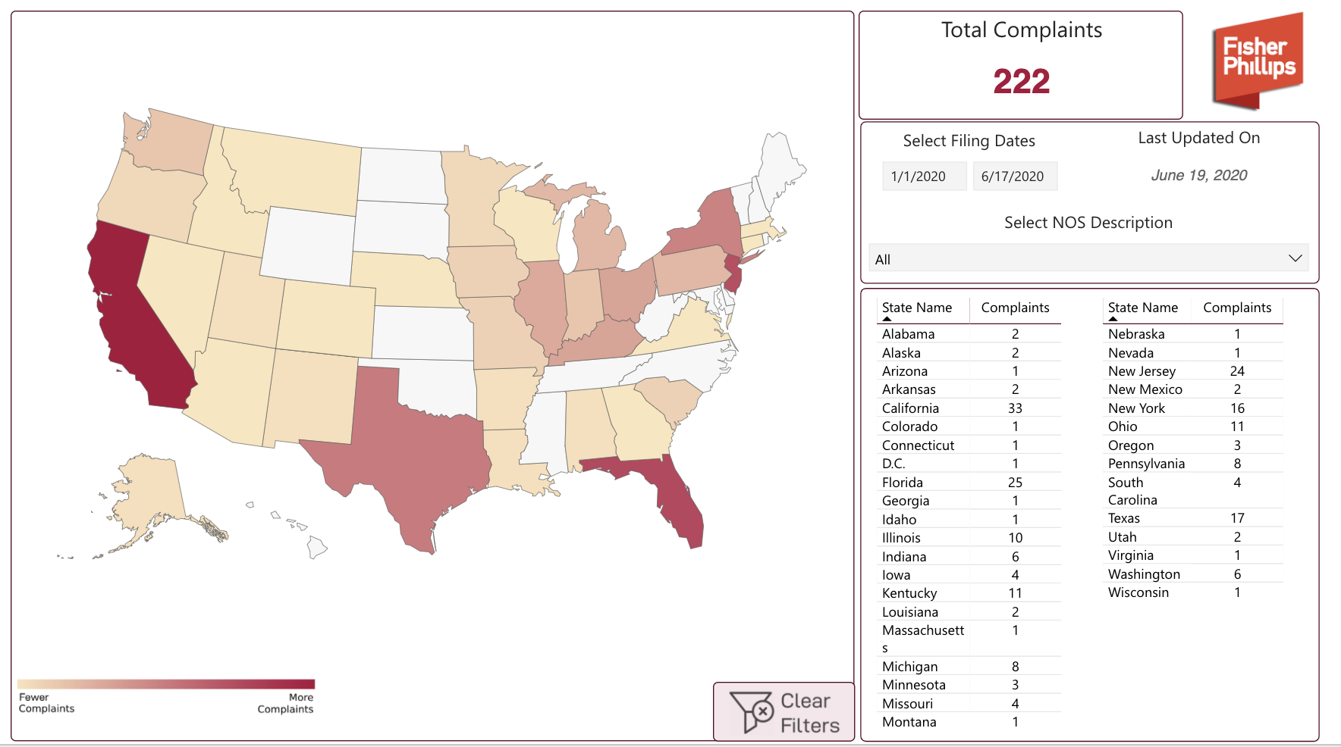
Litigation Risks
Number of cases that were a direct result of the COVID-19 pandemic and are traditional employee vs. employer cases

Slide 10

New Processes, New Compliance Risks
The pandemic forced many dealerships to adapt their sales and service strategies to meet demand for e-commerce and “concierge” offerings
Consumer preferences for online offerings will likely continue during this pandemic and beyond
Further, a NADA study found:
  61% of dealers said that digital retailing improved their efficiency
  24% of dealers increased the number of cars sold per person

Slide 11
New Processes, New Compliance Risks
If your process has changed you are more likely to have errors
Verifying a customer’s identity when they are wearing a mask
Properly running the red flag
Signing documents while social distancing can lead to errors/compliance issues

Slide 12
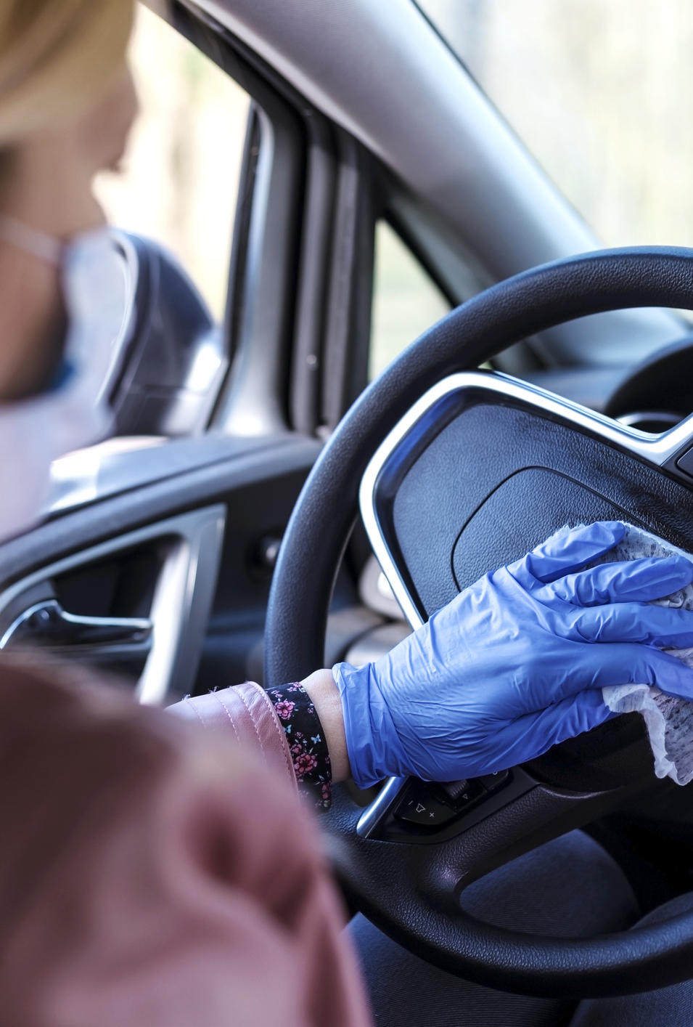
Staying on Top of COVID-19 Recommendations
Medical professionals are still learning about COVID-19 contagion and policies are changing rapidly
New regulations, guidance are being developed at the federal, state, and local levels
Businesses must stay on top of these shifting guidelines
  https://www.fisherphillips.com/
  https://www.kpa.io/insights/covid-19-coronavirus-resource-center

Slide 13



The Bigger Picture
FIRST AND FOREMOST,
PROTECT PEOPLE.
HOW YOU HANDLE
THIS MATTERS.
DIRECT AND INDIRECT
COSTS TO YOUR DEALERSHIP.
COVID-19 cases are continuing to grow across the U.S. Many experts are predicting another surge in cases in Fall 2020.
59% of survey respondents said dealership reputation was the most important factor when choosing which dealership to visit.
OSHA fines, litigation fees, absenteeism, medical expenses, lost productivity, all could end up costing your business tens of thousands of dollars
Notes:
https://v12data.com/blog/59-auto-shoppers-choose-dealership-based-reputation/#:~:text=According%20to%20the%20study%2C%2059,in%20such%20a%20competitive%20industry.

Slide 14
COVID-19 Risk Mitigation Strategies

Slide 15




Elements of an Effective Compliance Program
  Documentation
  Foundation of the program
  Memorializes policies
  Instructs employees
  Auditing
  Process validation
  Employee conformance
  Identity opportunities
  Corrective Action
  Modifications as needed
  Updated documentation
  Update training
  Training
  Conveyance of policies
  Shapes behavior
  Shifts some liability

Slide 16
OSHA Recordable
Document Request
OSHA 5020 Accident Investigation Form
OSHA 300 Log for 3 years
Cal/OSHA 5021 (Doctor’s First Report of Injury/Illness)
DWC Form 1
Injury Illness Prevention Program
Covid Policy
Covid Training Outline
Employee Training Records

Slide 17

Establish a Pandemic Response Team
Top Executives
Human Resources
Legal
Facilities Management
Union Representatives, if applicable

Slide 18

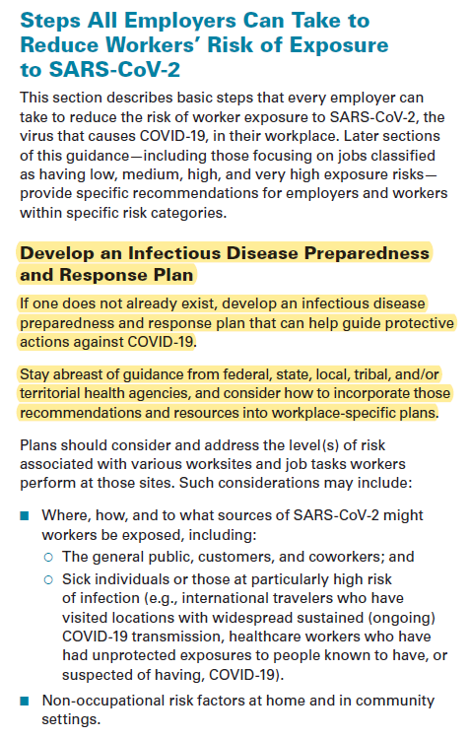
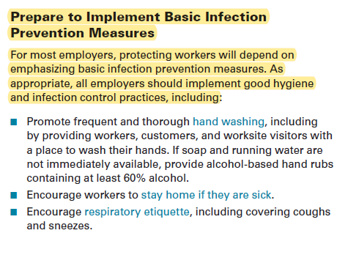
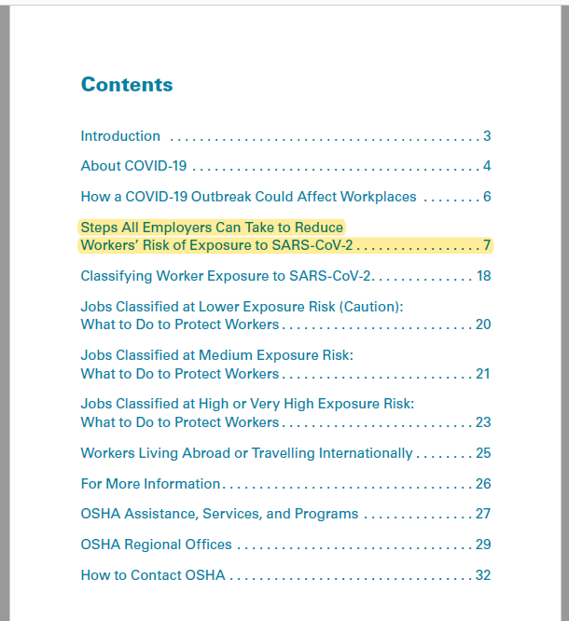
OSHA Compliance Updates

Slide 19

Develop Written COVID-19 Policies
A coronavirus response plan is not “optional”
This crisis will likely continue to spawn a wave of lawsuits in the months ahead
Reduce your dealerships’ liability should employees contract COVID-19 by thoroughly documenting and communicating policies and protocols
Written policies will also establish a good faith record of compliance if regulators show up after a compliant

Slide 20
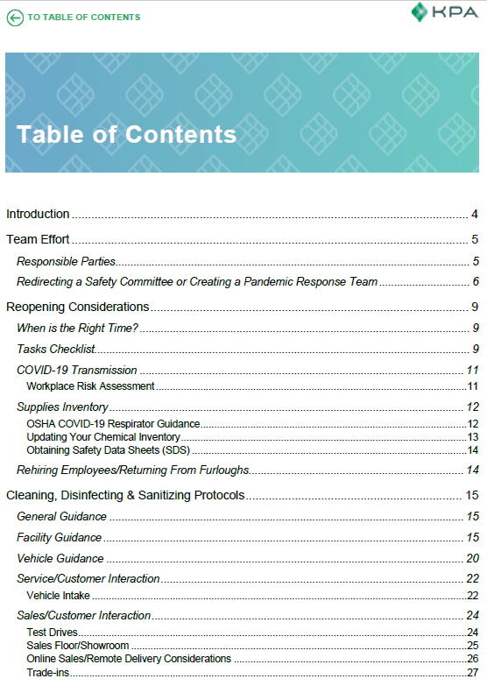
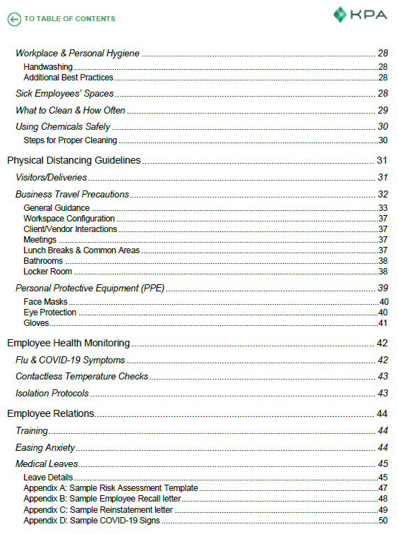
OSHA Compliance Updates

Slide 21

Embrace Online Training & Electronic Signatures
As employees are brought back from furlough and/or new hires are onboarded, proper training will be critical
Classroom-style employee training must be eliminated during the pandemic as group learning exposes employees to unnecessary coronavirus risks
As policies and COVID-19 recommendations change, ensure employees complete trainings reflecting updates
Ensure you have a record of complete training for all employees
Electronic signatures allow employees to quickly sign policies as they change and are more hygienic

Slide 22
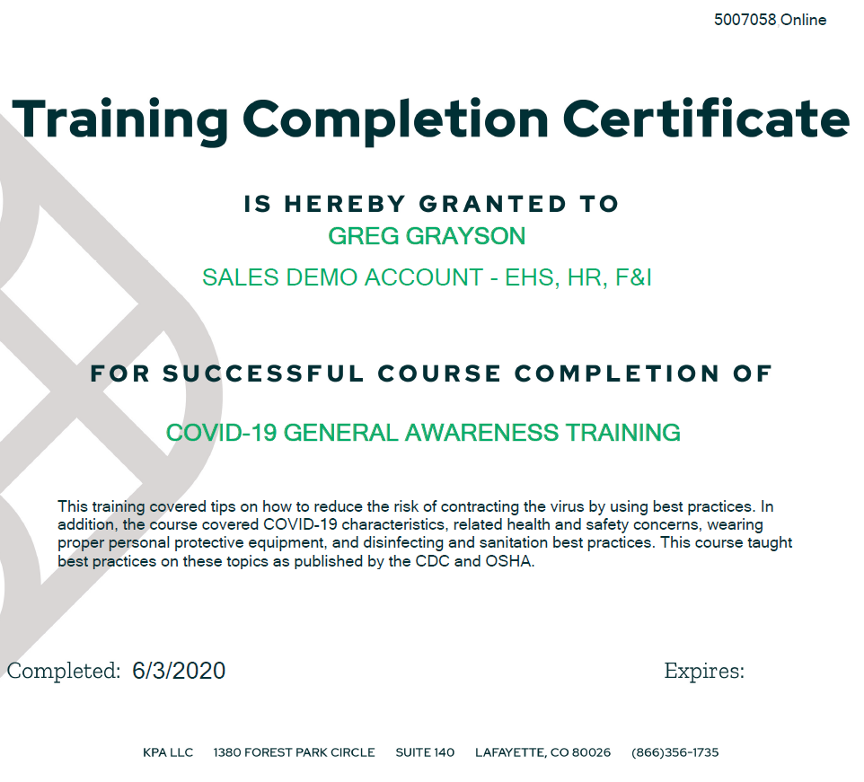
Train Your Employees on COVID-19 Safety
COVID-19 Characteristic
COVID-19 Precautions
  Avoiding the spread of germs
  Hand-washing
  Social Distancing
  PPE – Gloves
  PPE – Face Masks
Disinfecting & Sanitization
  Recommended Chemicals
  What to clean and disinfect

Slide 23
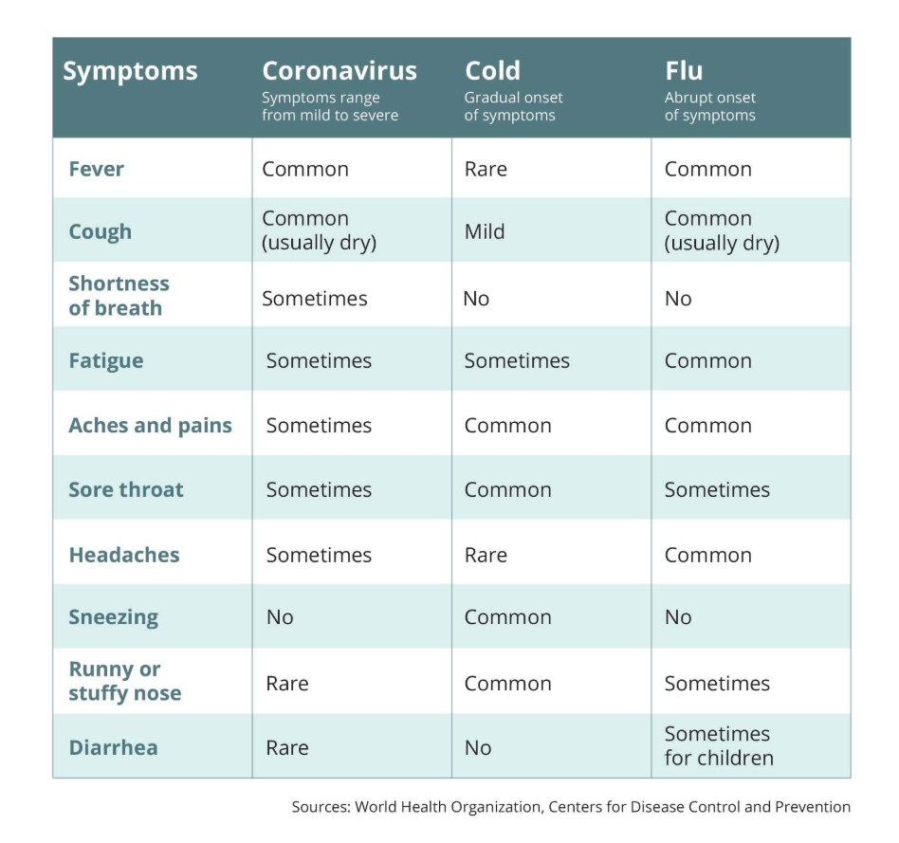
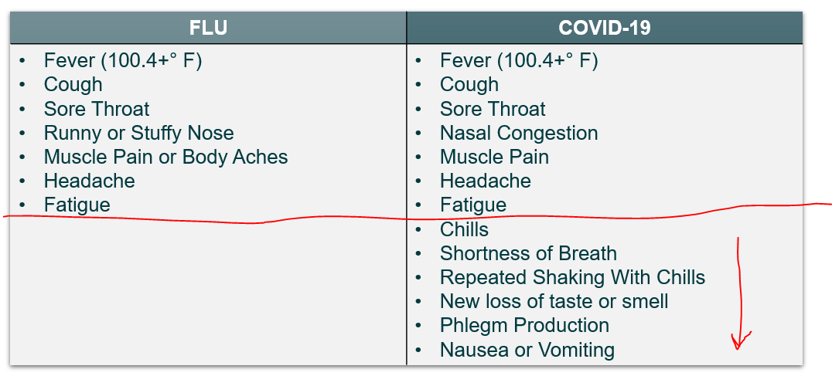
Train Your Employees on COVID-19 Safety
COVID-19 Characteristic

Slide 24
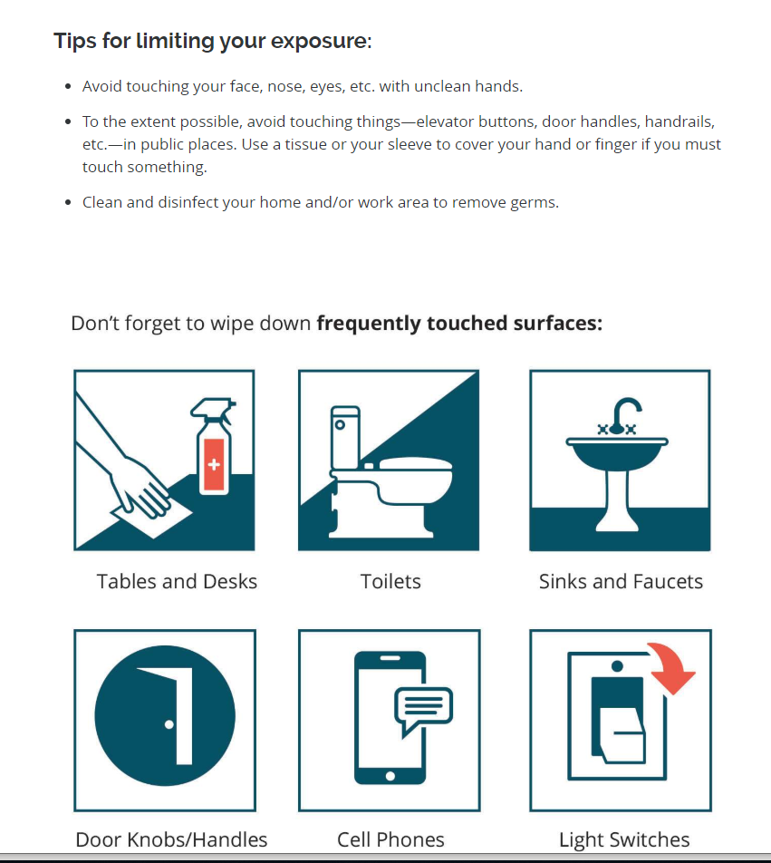

Train Your Employees on COVID-19 Safety
COVID-19 Precautions
Avoiding The Spread of Germs

Slide 25
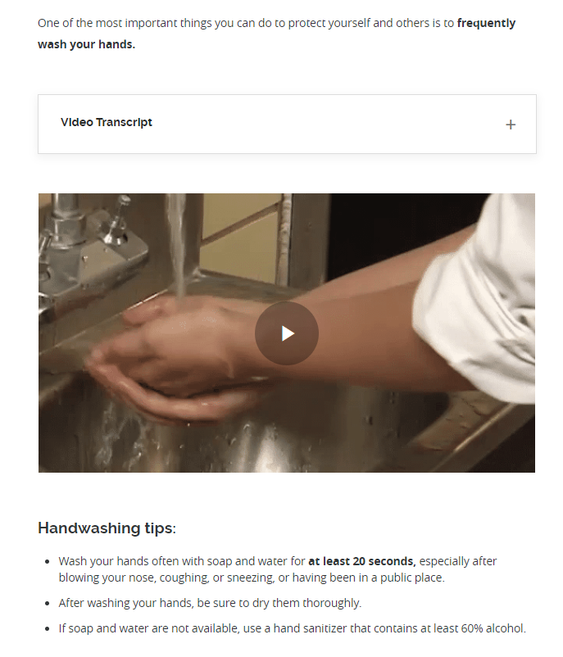
Train Your Employees on COVID-19 Safety
COVID-19 Precautions
Hand-Washing

Slide 26
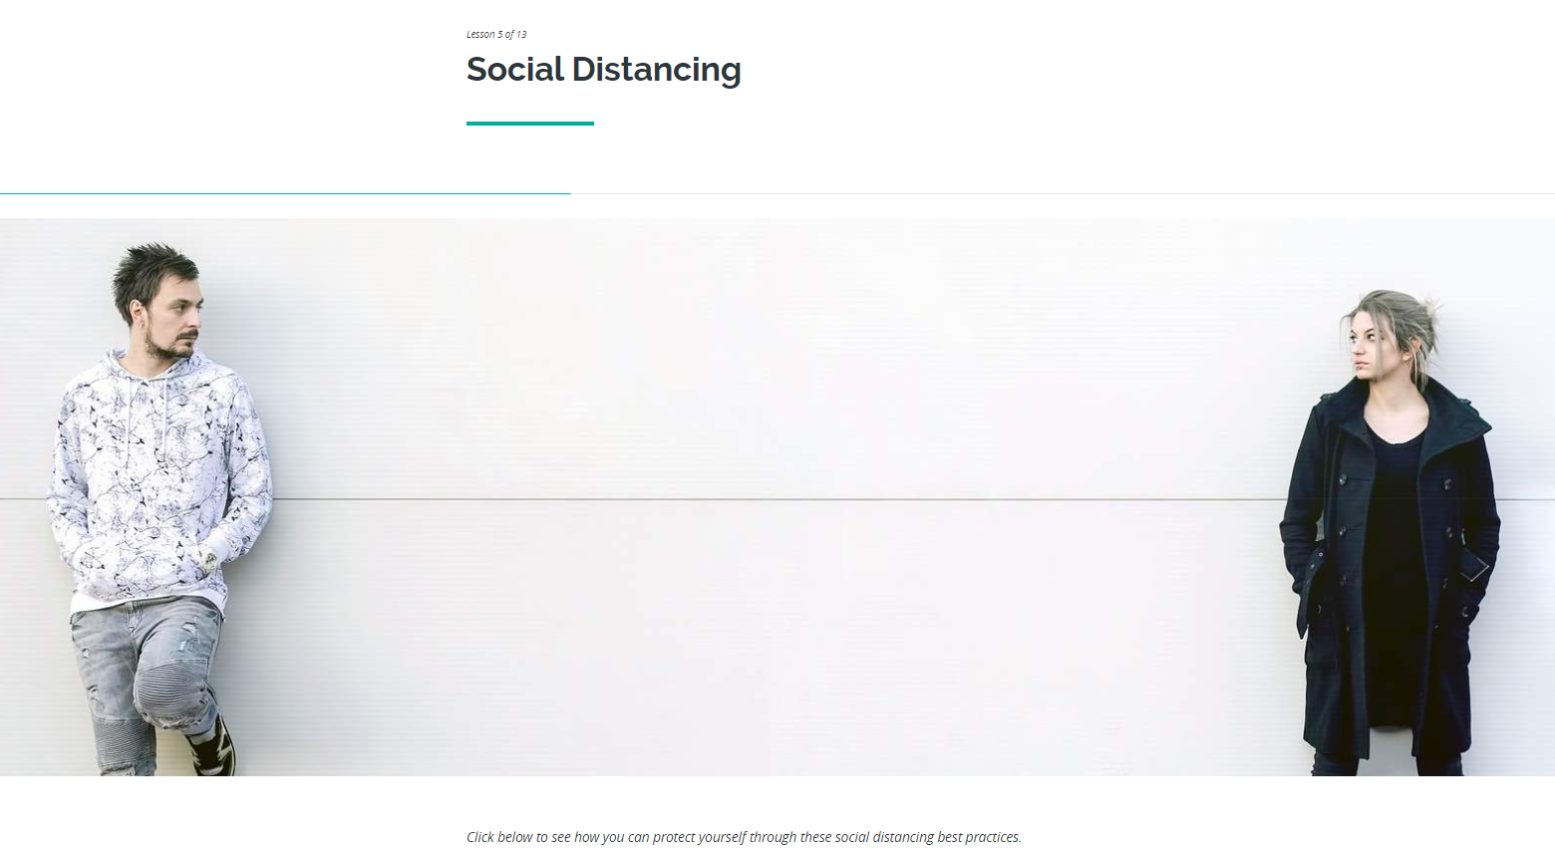
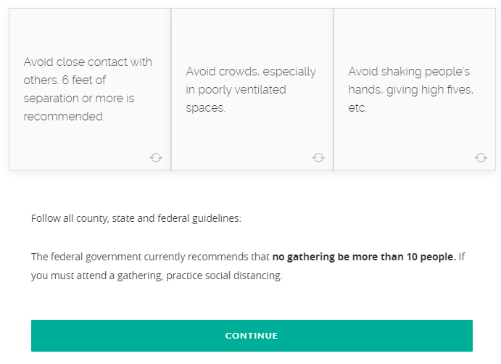
Train Your Employees on COVID-19 Safety
COVID-19 Precautions
Social Distancing

Slide 27
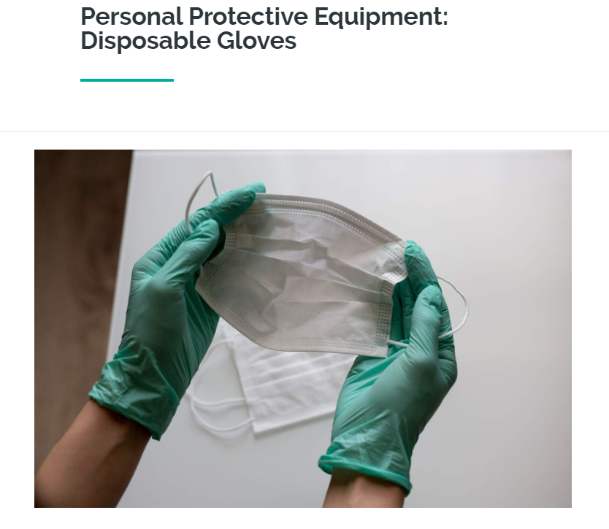
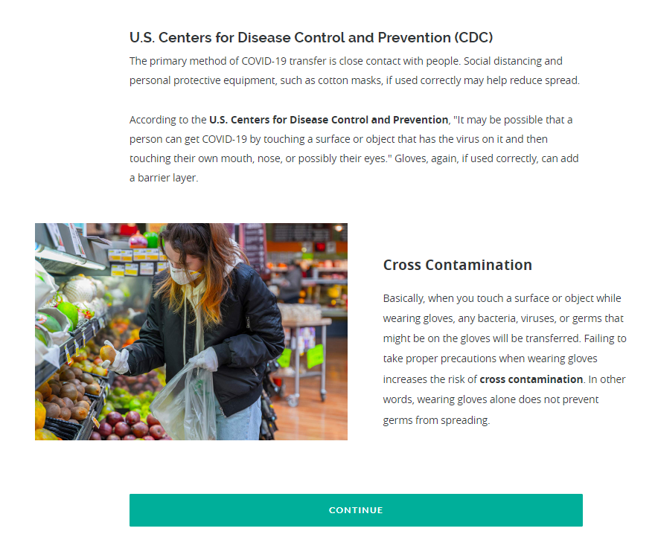
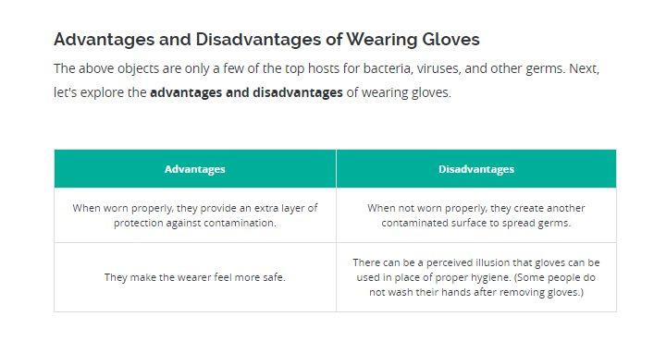
Train Your Employees on COVID-19 Safety
COVID-19 Precautions
Gloves

Slide 28
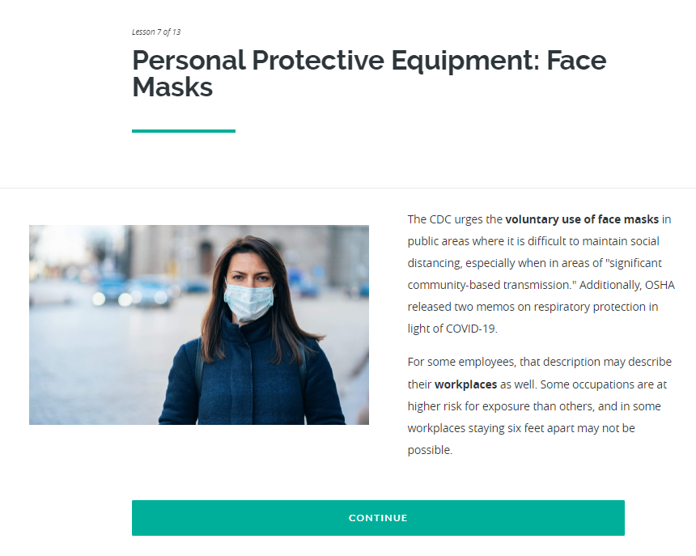
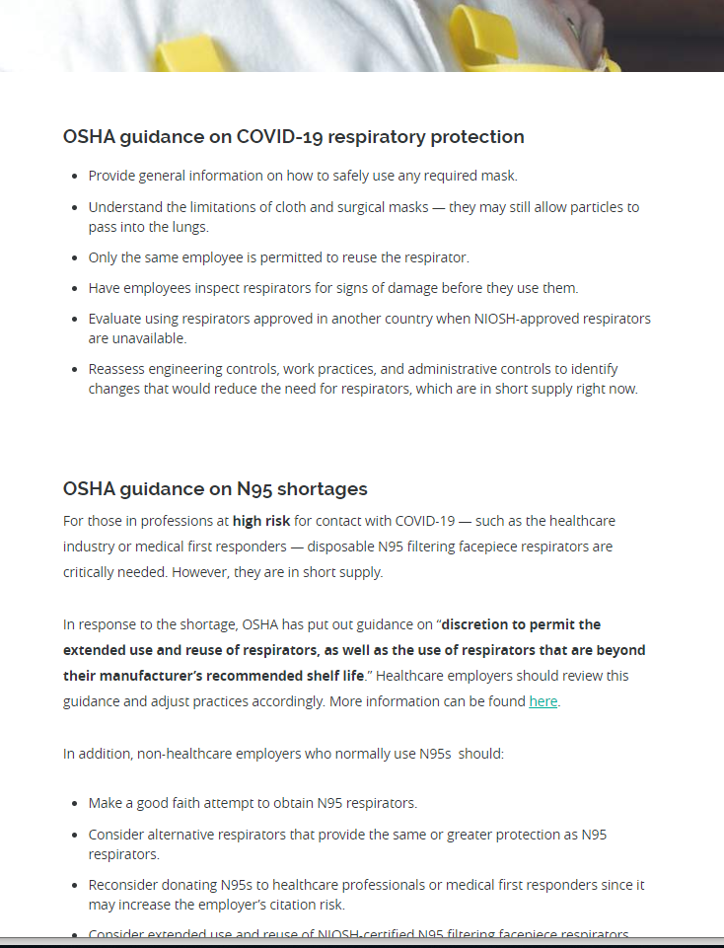
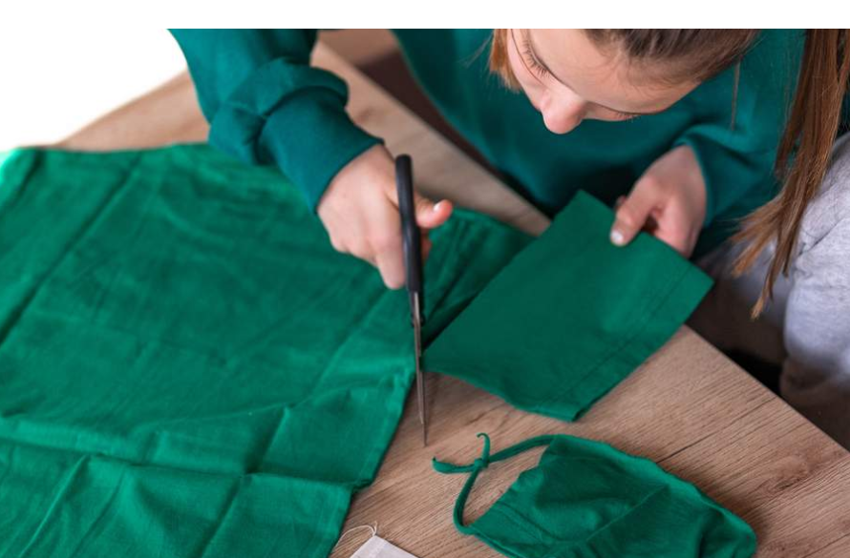
Train Your Employees on COVID-19 Safety
COVID-19 Precautions
Face Masks

Slide 29
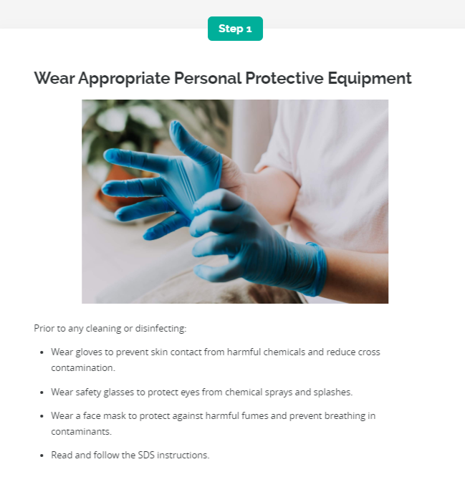
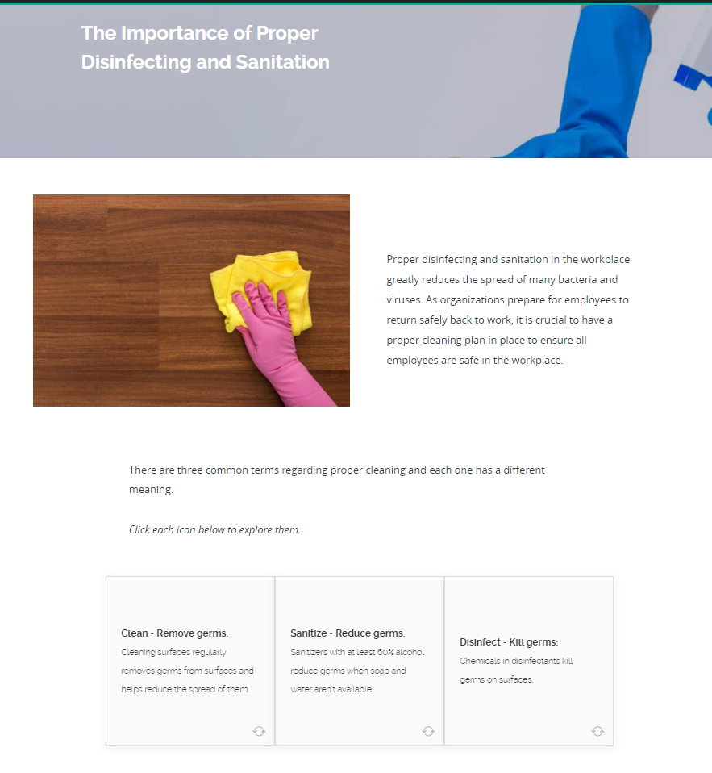
Train Your Employees on COVID-19 Safety
Disinfecting & Sanitization
  What to Clean and Disinfect

Slide 30
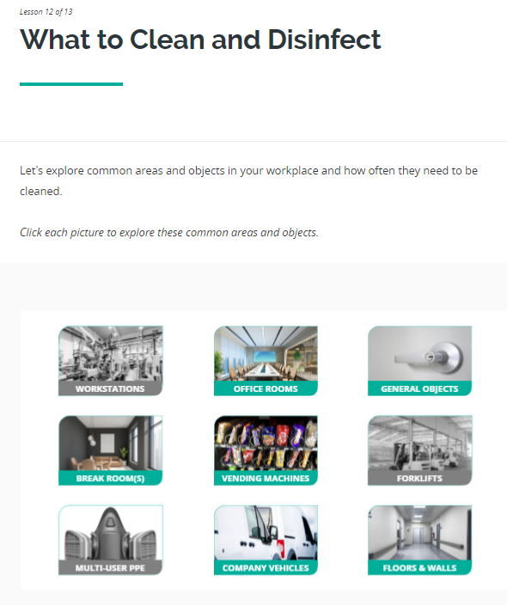
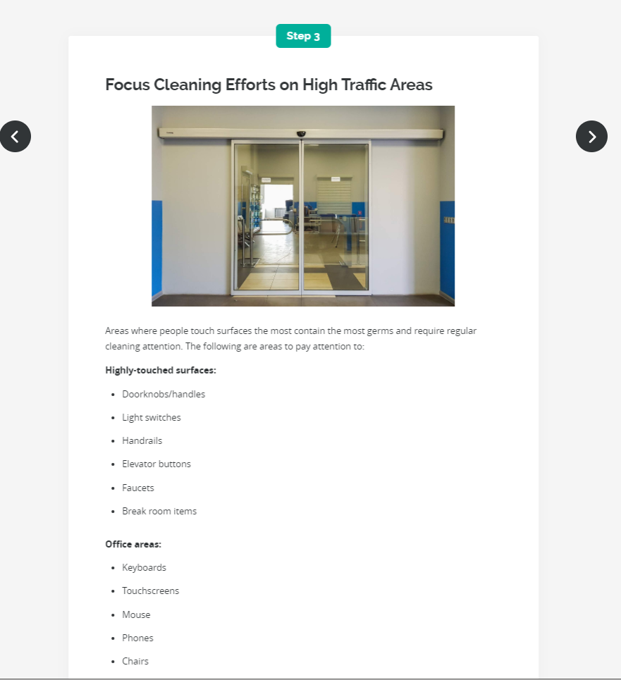
Train Your Employees on COVID-19 Safety
Disinfecting & Sanitization
  What to Clean and Disinfect

Slide 31
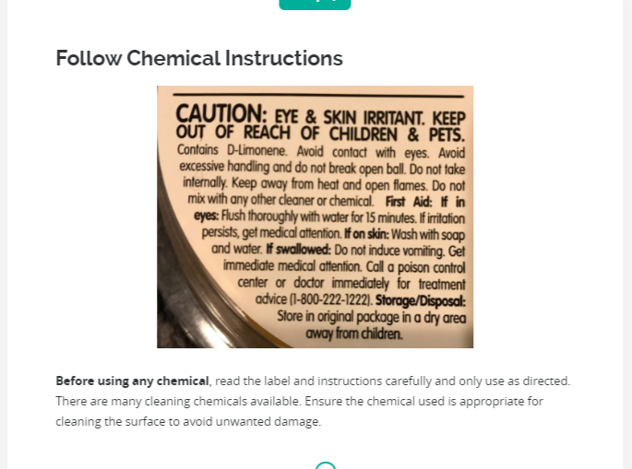
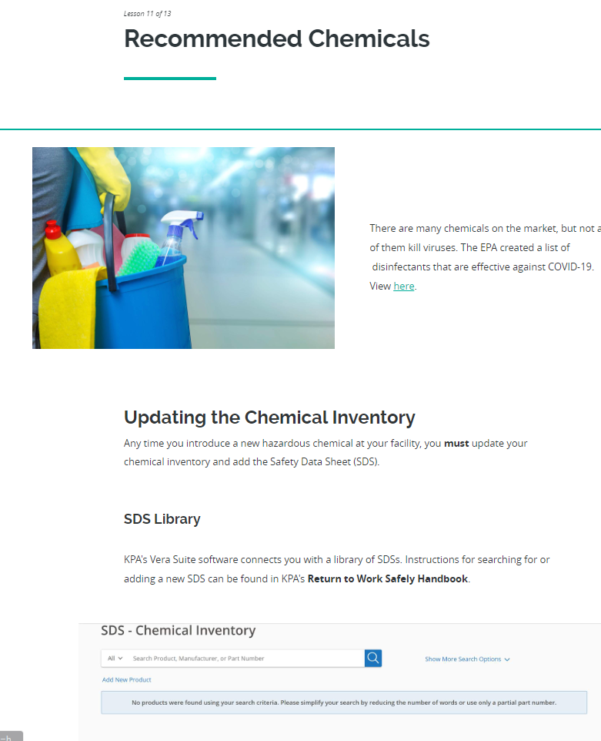
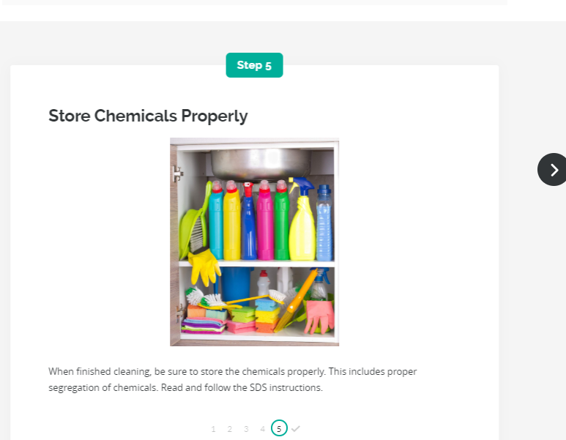
Train Your Employees on COVID-19 Safety
Disinfecting & Sanitization
Recommended Chemicals

Slide 32
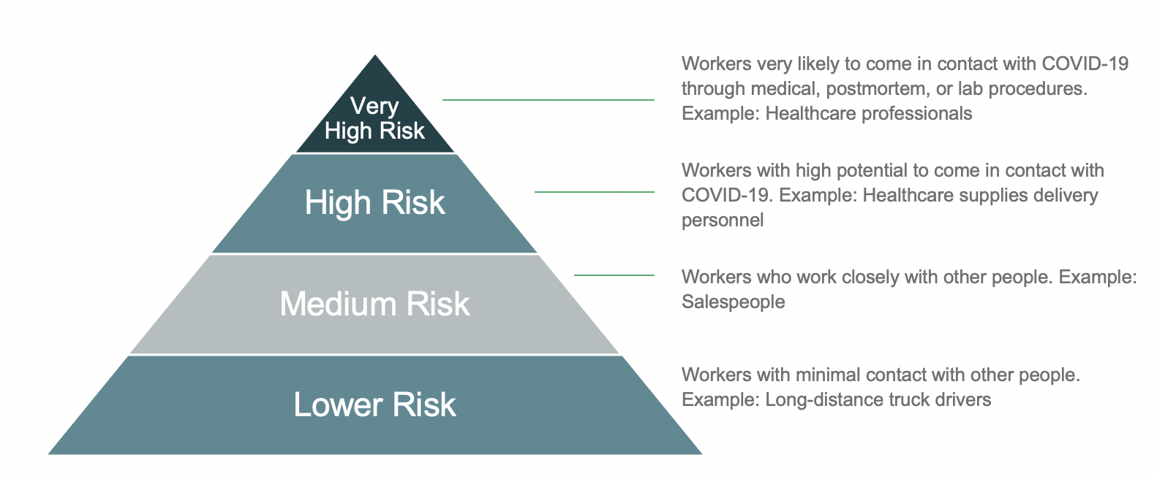
Workplace Risk Assessment
Evaluate for Every Position

Slide 33
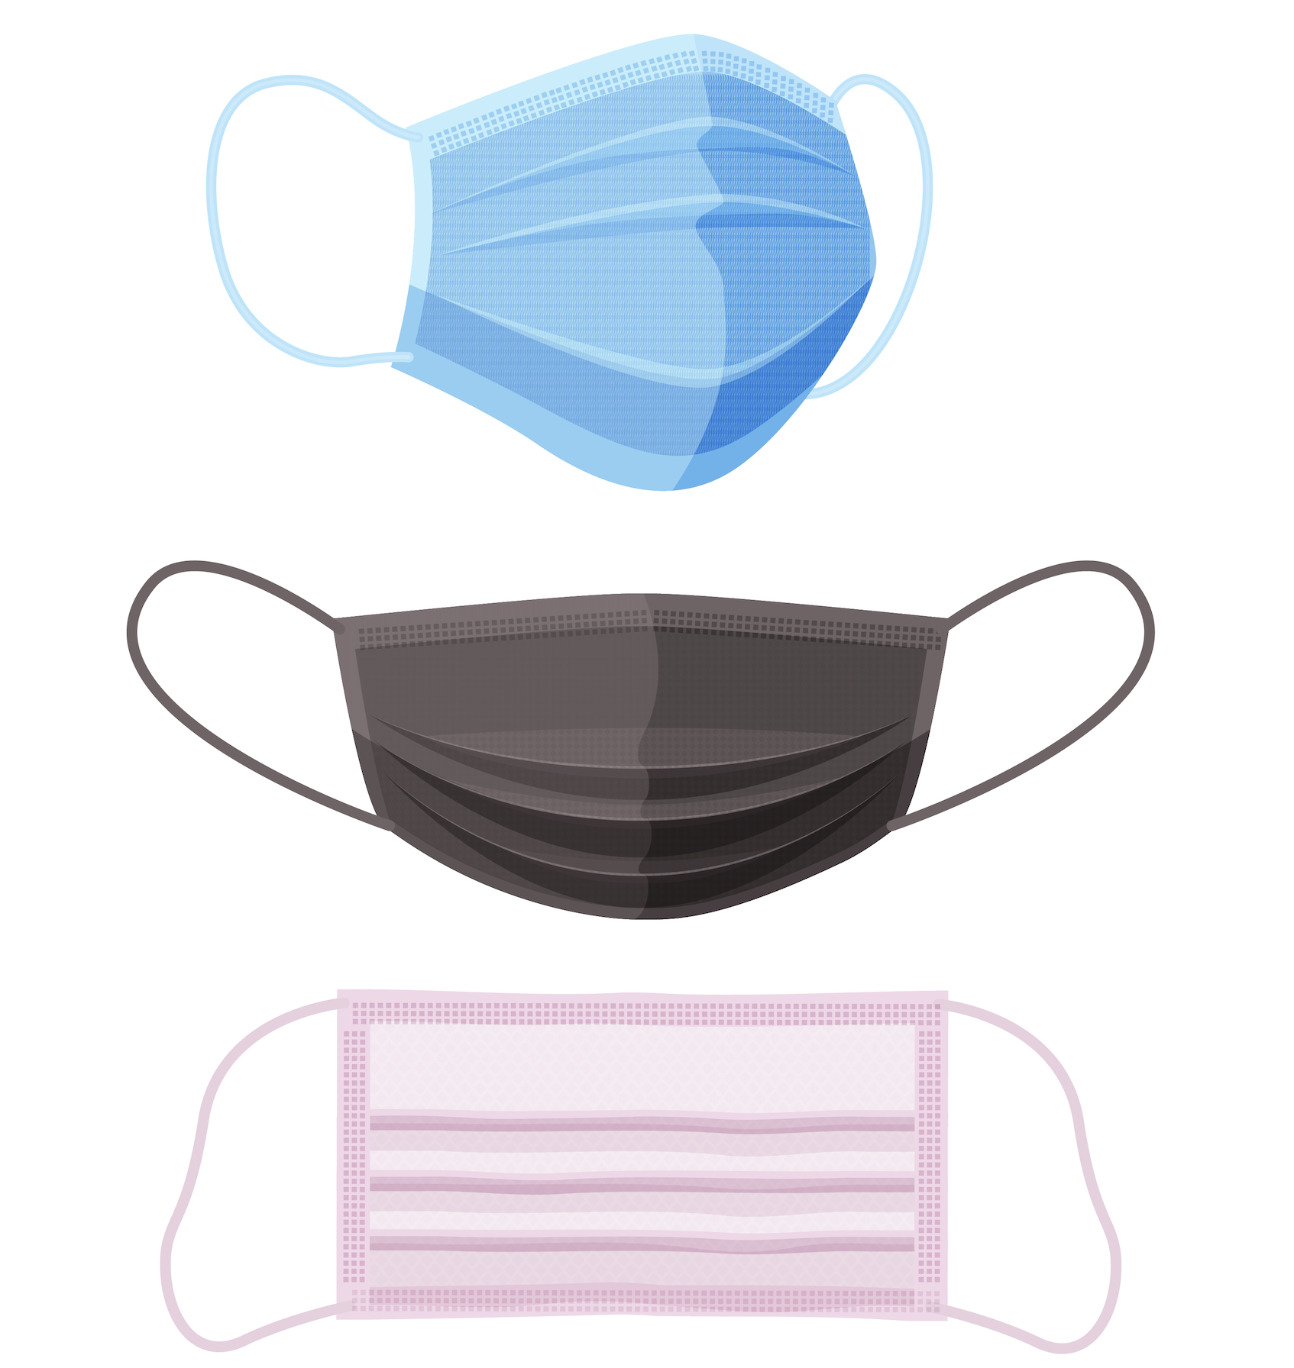
PPE
Primarily Face Masks | OSHA Guidelines | State Considerations
If you have N95 respirators for workers then you are required to train them.
Provide general information on how to safely use any required mask. (Appendix D)
Understand the limitations of cloth and surgical masks — they may still allow particles to pass into the lungs.
OSHA Guidance: Masks don’t replace social distancing.

Slide 34
Implement Engineering Controls
Eliminating Shared Workspaces
Partition Barriers
Roping Off
Increasing Workplace Ventilation
Using High Efficiency Air Filters

Slide 35
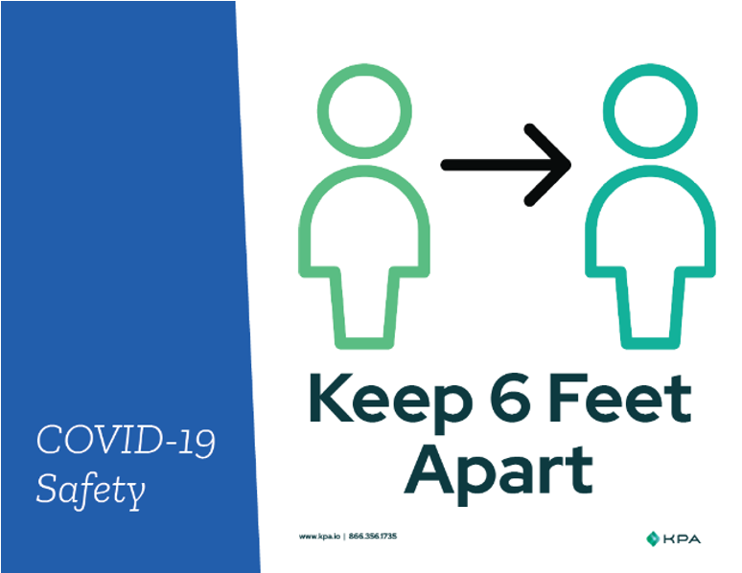
Implement Administrative Control
No Skin Contact Policy
Social Distancing Spacing
Handwashing Schedules
Assigned Entrances and Exits
Sanitizing Stations
Close Shared Amenities
Signage
Sanitizing Schedules

Slide 36

Audit Everything
As new process are introduced, engage a third-party expert consultant to audit your facility and procedures
Identify hazards and control methods to address COVID-19 at your dealership facility
Audit digital sales process to protect your dealership from fraud and risk
Review concierge services to ensure compliance with local, state, and federal regulations

Slide 37
One System to
Manage it All

Slide 38
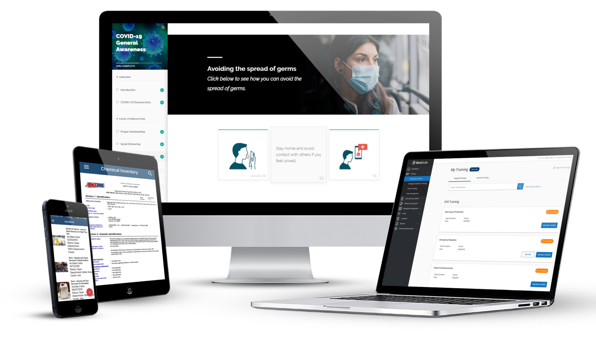
KPA’s COVID-19 Safety Program
Comprehensive Tools, Training and Consulting Services
Industry-specific Handbooks
Written Program Templates
Templates & Sample Policies
Reopening Assessments
Online Training Courses
Monthly Focus on Safety — Special Editions
Consulting Services
Facility Audits
This program will help you remain compliant with OSHA, state, and local regulations

Slide 39
Questions

Slide 40



Contact Us
    +1 (866) 356.1735
    www.kpa.io
    info@kpa.io
KPA’s COVID-19 Resource Center:
www.kpa.io/covid-19
Notes:
Thank you for your time today. If you have additional questions please feel free to reach out to us at info@kpa.io and please visit our COVID-19 resource center at kpa.io/covid-19. We will continue to update that page with new information and materials as they become available. You can also get updated information from KPA by following us on Twitter @kpaonline or LinkedIn.
We hope that you gained helpful information and will consider joining us again.
Have a great day!

