Slide 1
INDEPENDENT ADVOCATES DELIVERING RISK-FREE, PROVEN RESULTS
Your Credit Card Processing Fees Are Going Up! Learn How to Mitigate It
Confidential 5.18.22

Slide 2
Today’s Discussion With Eric Cohen
Finance industry veteran Eric Cohen, has 25 years of experience in the credit card processing world and experience and extensive knowledge of the true cost of a transaction. He has helped thousands of businesses optimize their accounts to achieve unparalleled cost savings. As the founder of Merchant Advocate, he understands the ins and outs of the merchant services business and will help create transparency in the unregulated processing world.

Slide 3
The System That Allows You to Collect Money is Costing You More Than it Should
Credit card processing is largely unregulated
New regulations and complicated statements are designed to create confusion
Processors raise rates 2-3x every year
Even the most accredited financial institutions and banks make mistakes

Slide 4
The Lifecycle of a Transaction
Customer
Makes purchase
Merchant
Receives order info and manages billing
Gateway
Sends request to
processor
Processor
Sends information to proper card association
Association
Will route request to
proper issuer through its network
Issuer
Approves (or declines) the transaction and returns the response to the network
Customer
Is billed by the issuer on their monthly statement

Slide 5
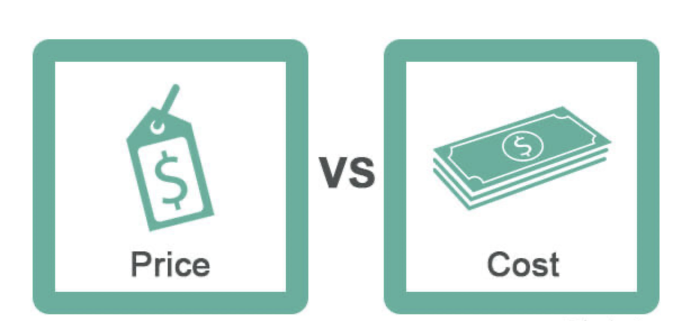
Rate vs True Cost
Who is your salesperson and what do they know?
Banker
Friend
Referred by Software
Direct Processor
ISO, SUB ISO, AGENT
Are you being told the whole truth?
Information withheld intentionally
Lack of proper training and understanding of the process
Processors don’t want to disclose everything
Changing Processors
If you have ever changed processors, do you know if you ever saved money?
Most processors will not report the savings they achieved for you

Slide 6
All Merchant Accounts Are Not Created Equal
Coding & Optimization
Visa/MasterCard/American Express coding is related to the SIC codes you are programmed with by the processor
Usually determined by sales agents and data entry personnel
Not for Profit, Hand-Keyed, Swiped, Insurance
INTERCHANGE IS FIXED.
HOWEVER,
THERE ARE WAYS TO
OPTIMIZE
YOUR TRANSACTIONS

Slide 7
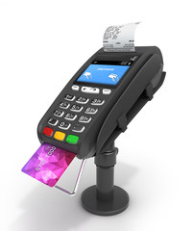
Processing Methods
Standalone terminal
Standalone terminals
What terminal do you have?
Is it EMV compliant?
Lease vs. purchase and costs
Integrated terminals with Gateway / EMR Integration
Terminal cost
Gateway integrations - Which can you use?
Gateway transaction fees and monthly charges
Can the gateway optimize each transaction?
Gateway

Slide 8
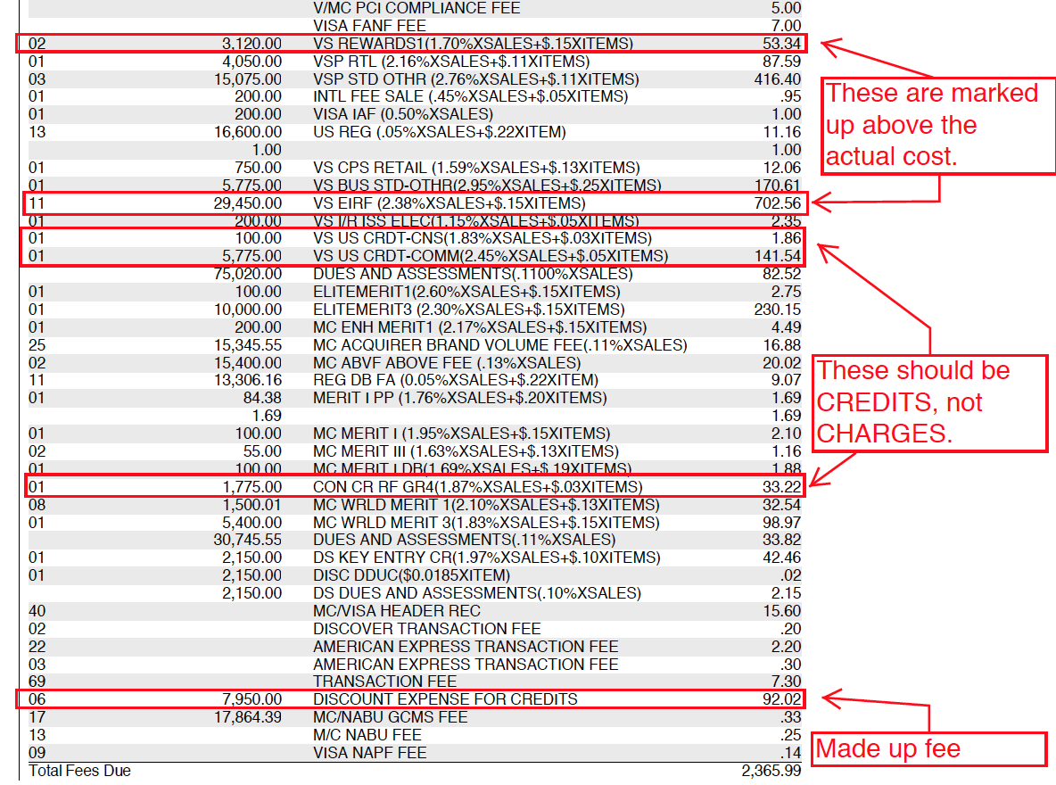
Sample statement with marked-up, made-up fees, and incorrect charges/credits

Slide 9
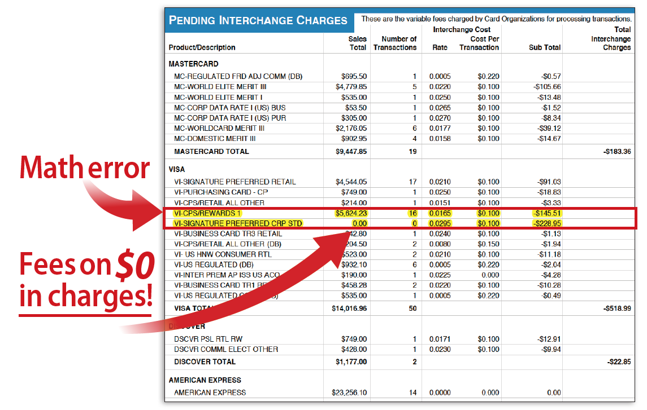
Are You Doing the Math?

Slide 10
Sample statement with inflated and escalating rates
February
Inflated Rates
Negotiated Rates
April
Processor increased again
July

Slide 11
Case Study: Major Auto Dealership
Savings Info: Implemented a new pricing program from Tiered to Interchange Plus
Account Details: Negotiated significant savings
Highlight: Gross savings of hundreds of thousands to date

Slide 12
Case Study: NJ Auto Dealership
Savings Info: Reduced Technology/Security and EMV fee from .30%
to 0%
Account Details: Uncovered hidden fees; thousands of dollars were refunded
Highlight: Gross savings of $133,000 to date

Slide 13
Your Silent Equity Partner
Make sure the system collecting your money isn’t costing more than it should:
Get audited
Monitor your account
Make sure are your business is PCI compliant
Protect yourself from breaches

Slide 14
Questions?
Eric Cohen, CEO
eric@merchantadvocate.com
(732) 727-2073
Allie Lubart, AE
alubart@merchantadvocate.com
(917) 957-9073
A trusted leader in merchant advocacy
http://www.merchantadvocate.com

